Slide 1
Modern Contraceptive Care: Key Insights for Women’s Health Care Professionals
Dr Neepa Thacker
Dr Vera Martins
GPs & NAPS Trustees

Slide 2
Agenda:
3 to 4 contraceptive cases
Interactive!
FRSH/NAPS/BMS guidelines

Slide 3
Case 1: - 26y female - Microgynon30 for 18 months - 21/28 regimen regularly with monthly bleed - Irritability, mastalgia, bloating before period - POP previously caused low mood/acne - Not keen on LARC/intrauterine methods - PMH: Nil of note - PGH: Nil of note. G0P0. UTD smears – normal - DH: Nil - SH: Non-smoker, EtOH 2units/wk, no drugs. In same sex relationship for 15 months. - O/E: BP 112/78, BMI 24

Slide 4
Which is the most suitable contraceptive option?

Slide 5
NAPS guidelines 2025:
Initial management of young woman with PMS would be simple reversible suppression of the ovarian cycle using any ovulation suppressing hormonal contraceptive.
COCP considerations:
Continuous COCP containing ethinylestradiol plus any progestogen
If PMS symptoms in a 21/28 regime, a 24/28 regimen or continuous can be suggested
Phasic pills not recommended
If any progestogenic side effects, Drosperinone containing COCP (e.g. Yasmin, Eloine) may be better tolerated
POP considerations:
Desogestrel stops ovulation and could be considered for women with risk factors or CI for the COCP
Women with hormone sensitivity cannot tolerate desogestrel
Drosperinone POP = a new alternative that is better tolerated

Slide 6
FSRH CEU Statement: Drosperinone 4 mg progesterone-only pill 10 Jan 2024
Drosperinone pill (Slynd)
Pill-taking regime | Continuous cycle of 24 consecutive daily 4 mg DRSP pills followed by 4 inactive pills (4-day hormone free interval)
Contraceptive effectiveness | Primarily suppresses ovulation. Additional contraceptive effects on the mucus and endometrium Perfect use = 99% effective
Starting DRSP POP | Start on day 1 of cycle. If quick-started at any other time, advise condoms/abstinence for 7 days
Medical Eligibility | DRSP is a spironolactone derivative – an aldosterone antagonist with additional mild anti-androgenic activity Recommendations for POP (UKMEC) apply to DRSP POP Hyperkalaemia has been observed. CI in renal insufficiency or acute renal failure. Consider U&E monitoring in mild/moderate renal impairment, Addison’s disease, individuals at risk of CKD (>50y) and those taking potassium supplements/drugs causing high K
Side effects | Unpredictable bleeding – less unscheduled bleeding than traditional POP due to 4-day hormone free interval
Non-contraceptive benefits | Beneficial effect on mildly elevated BP Theoretically DRSP anti-androgenic activity could be beneficial for acne, and management of PMS or PCOS

Slide 7
Pill Ladder
Adapted From https://gpnotebook.com/en-GB/pages/gynaecology/oestrogen-and-progestogen-effects-of-coc
Less progestogenic activity
 | Levonorgestrel (LNG) | Norethisterone (NET) | Norgestimate (NGT) | Gestodene (GSD) | Desogestrel (DSG) | Drosperinone (DRSP)
35 mcg EE |  | Brevinor Norimin | Cilique Lizinna
30 mcg EE | Microgynon 30 Rigevidon Ovranette Elevin, Ambelina Levest, Maexeni |  |  | Akizza 30/75 Femodene Katya 30/75 Millinette 30/75 | Gedarel 30/150 Cimizt Marvelon | Yasmin Dretine Lucette Yacella Yiznell
20 mcg EE |  |  |  | Femodette Millinette 20/75 Sunya Akizza 20/75 | Bimizza Gedarel 20/150 Mercilon | Eloine (Yaz)
Less oestrogenic activity

Slide 8
Side Effects:
Oestrogenic | Progestogenic
Nausea | Acne
Bloating | Greasy hair
Weight gain (water retention) | Hirsutism
Vaginal discharge (+/- infection) | Weight gain (↑ appetite)
Breast enlargement/tenderness | Depression
Severe headaches | Loss of libido
Chloasma (melasma) | Vaginal dryness
Photosensitivity

Slide 9
Case 2: - 36y female - Requesting contraception - Keen to lose weight for summer wedding - PGH: Nil of note. G0P0. UTD smears – normal - PMH: Appendicectomy - DH: Mounjaro injections (Tirzepatide) for 1/12 and has lost 3kg - SH: Male partner for 8 years. Non-smoker, EtOH 4units/wk, no recreational drugs - O/E: BP 134/82, BMI 37
Notes:
36 y Woman with BMI 37 seeks contraception. Looking to lose weight prior to wedding in the summer. DH – mounjaro injection for the last month (lost 3 kg). With male partner for 8 years. PMH – appendicectomy. No gynae hx of note. G0P0. SH – nonsmoker, teetotal, no recreational drugs.

Slide 10
Which is the most suitable contraceptive option?

Slide 11
Obesity & Contraception
IUC
Highly effective. Evidence suggests that effectiveness not affected by BMI
Implant
Highly effective. Evidence suggests that effectiveness not affected by BMI
Progesterone-only injectable
Effectiveness not affected by BMI
↑ BMI with multiple CVD risk factors (e.g. smoking, diabetes, HTN) = UKMEC 3
POP
CHC
Licensed duration of ENG is 3 years and applies to all women of all BMIs
Effectiveness not affected by BMI
Associated with weight gain, particularly women <18 with BMI >30
Consider subcutaneous DMPA or longer needle or deltoid administration if IM
Double dose POP for contraception is not recommended for women who have a raised BMI
Safe option
Safe option
Effectiveness of COCP not affected by BMI
Possible reduction in combined patch effectiveness in women >90 kg
Limited evidence suggests effectiveness of vaginal ring not affected by BMI
UKMEC 2 for women with BMI 30-34 and UKMEC 3 for women with BMI >35

Slide 12
Contraception & Weight management treatment considerations
Advise women that medications that induce diarrhoea and/or vomiting (e.g. orlistat, laxatives) can reduce effectiveness of POP, COCP and oral EC
Women considering bariatric surgery should discuss and have a contraceptive plan in place prior to surgery
Advise women that the effectiveness of OCP (inc oral EC) could be reduced by bariatric surgery and should be avoided in favour of non-oral methods of contraception
Advise women to stop CHC and switch to an alternative effective contraceptive method at least 4 weeks prior to planned major surgery (e.g. bariatric) or expected period of limited mobility

Slide 13
Case 3: - 29y female - UPSI 48 hours ago with male partner of 6 months (condom split) - Would like EC asap - Normal regular cycle (29-30 day cycle) - PGH: Nil of note. G0P0. UTD smears – normal - PMH: Nil of note - DH: Nil - SH: Social smoker (2/wk), EtOH 8-10 units/wk, no recreational drugs - O/E: BP 128/81, BMI 32

Slide 14
Which is the most suitable emergency contraceptive option?

Slide 15
Obesity & Emergency Contraception treatment considerations
Inform women that Cu IUD is the most effective method of EC
Inform women that BMI >26 or weight >70 kg may reduce effectiveness of oral EC, particularly LNG-EC
Consider UPA-EC and if this is not suitable, double dose (3 mg) LNG-EC if BMI >26 or weight >70 kg. (NB: The effectiveness of double dose LNG-EC is unknown)
Double dose UPA-EC is not recommended for women of any body weight or BMI

Slide 16
Case 4: - 51y female on HRT for 3 years: - Estradot 50mcg patch twice weekly - Mirena IUS inserted age 46 (traumatic) - Menopausal symptoms well controlled - No bleeding - PGH: G2P2. UTD smears/mammogram – NAD - PMH: Hypercholesterolaemia, hormonal migraines (without aura) - DH: As above - SH: Ex-smoker (occ vapes), EtOH 4 units/wk, no recreational drugs - O/E: BP 124/72, BMI 25

Slide 17
Which is the most suitable management option?

Slide 18
FSRH guidance: Contraception for women > 40 years
IUC
Extended use of copper IUD until menopause when inserted ≥ 40yrs
Extended use of a 52mg LNG IUS for contraception until 55yrs if inserted at ≥ 45yrs, provided it is not being used as the progesterone component of HRT
Implant
Implant is not associated with increased risks of VTE, stroke or MI and has not been shown to affect BMD
DMPA
Women > 40yrs using DMPA should be reviewed regularly to assess the benefits/risks of use.
POP
CHC
Can be safely used and stopped at 55yrs
Women > 50yrs should be counselled on alternative methods
POP is not associated with increased risks of VTE, stroke or MI
Can be safely used and stopped at 55yrs
COCP with LNG or NET should be 1st line for women > 40yrs due to potentially lower VTE risk
Women ≥ 50yrs should be advised to stop CHC to use an alternative, safer method
COCP with < 30 EE should be 1st line due to potentially lower risks of VTE, CVD and stroke

Slide 19
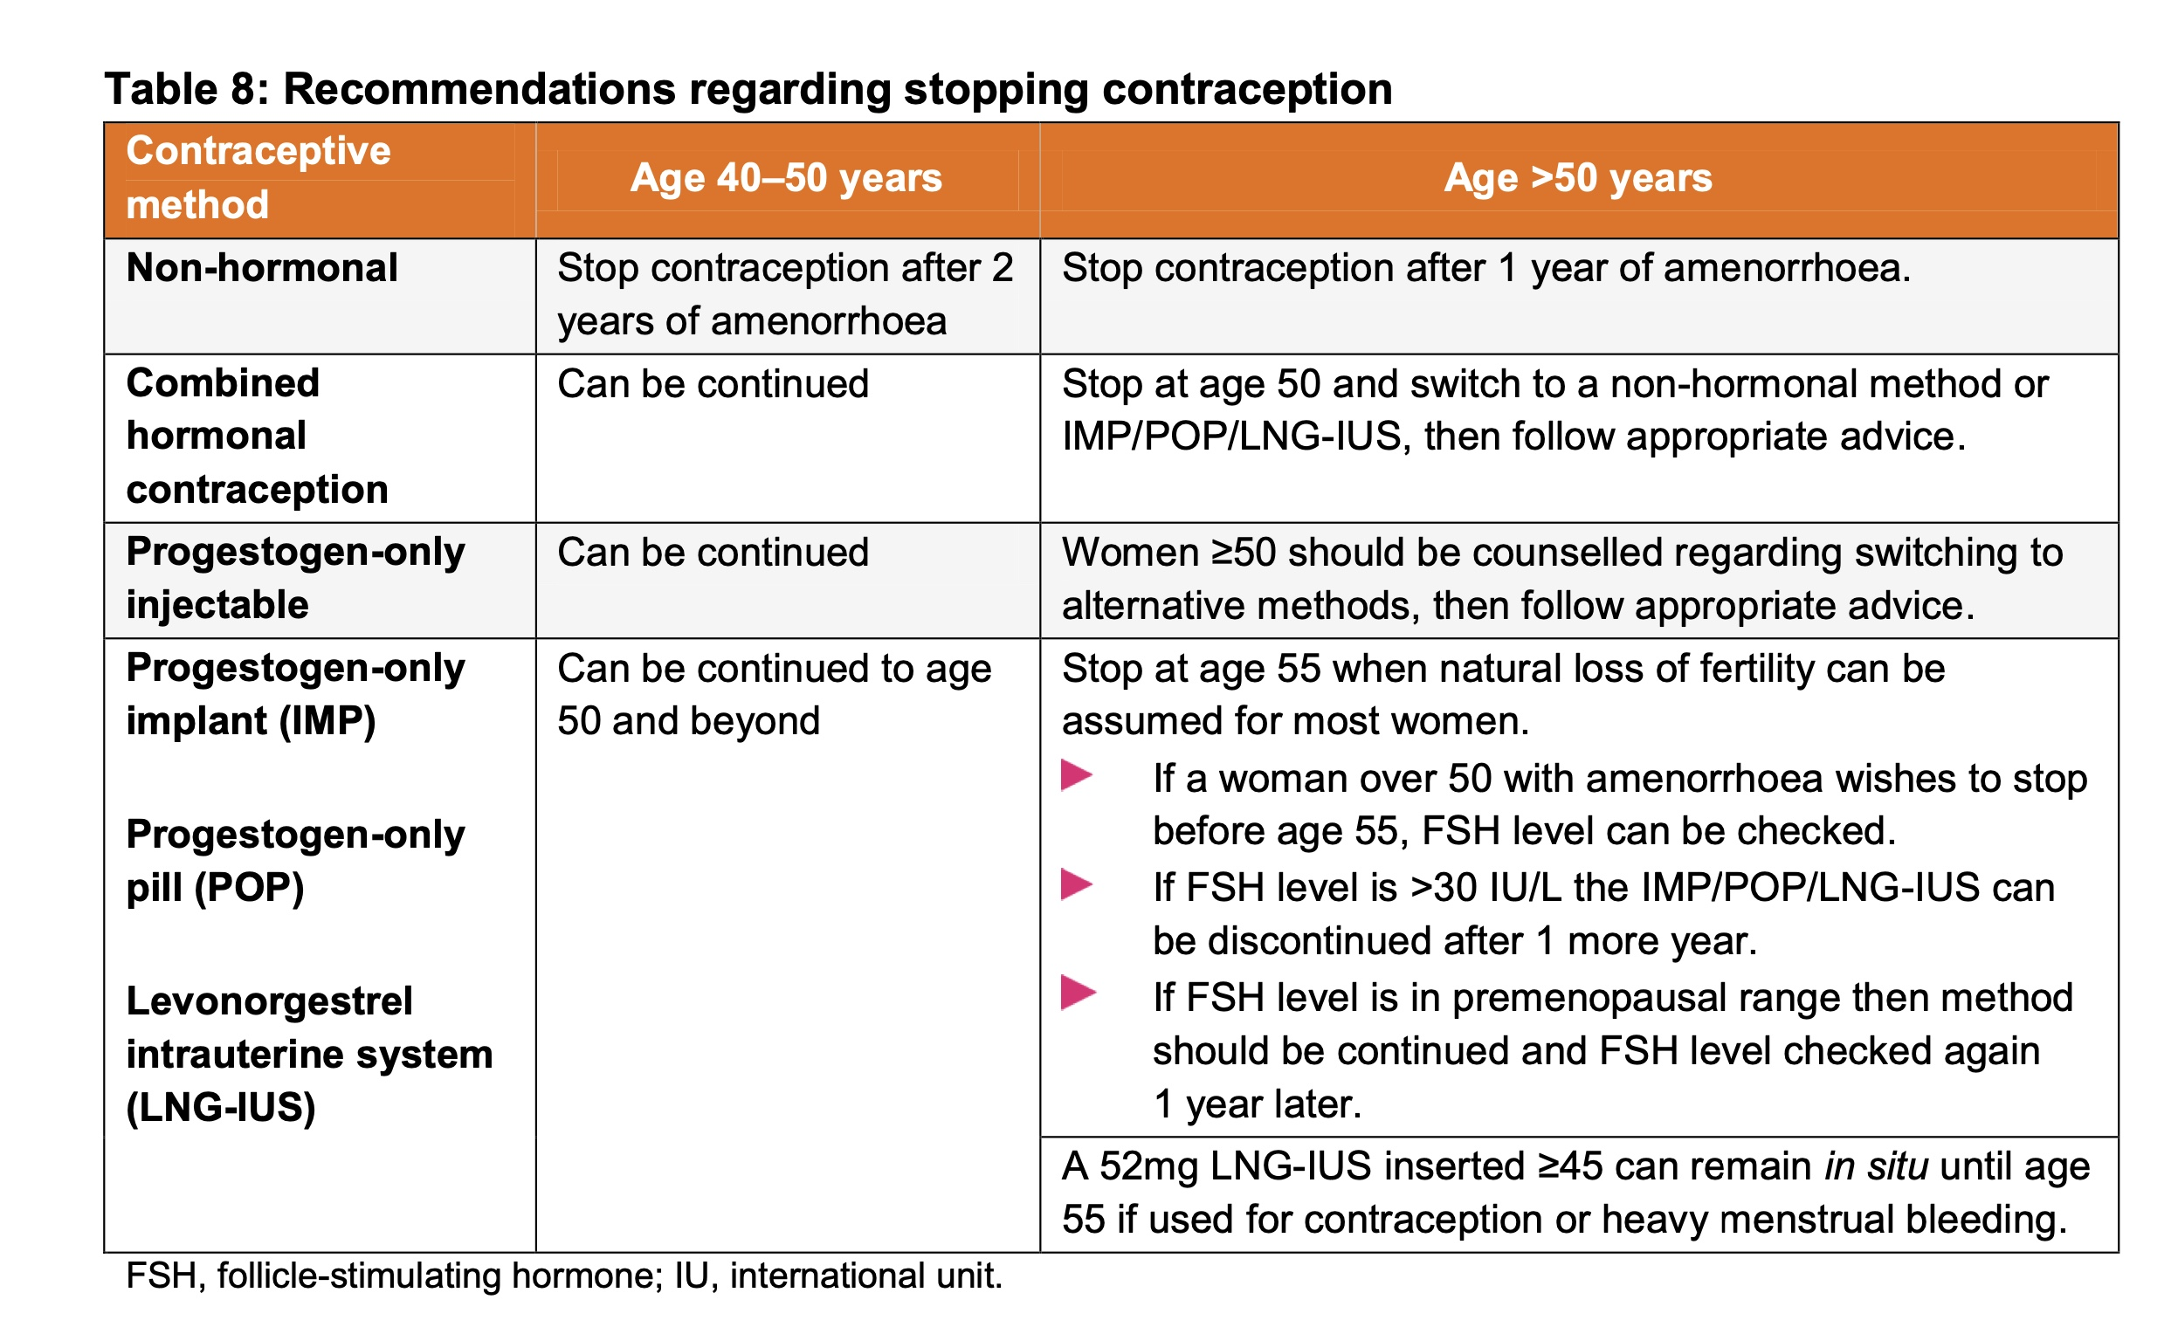
FSRH Guideline Contraception for Women Aged over 40 years, August 2017 amended July 2023

Slide 20
Thank you for listening!
Summary:
3 to 4 contraceptive cases:
PMS
Obesity
Emergency contraception
Perimenopause
FRSH/NAPS/BMS guidelines
Any Questions?

Slide 21
References/Resources: - NAPS Guidelines 2025 - FSRH CEU Statement: Drosperinone 4 mg progesterone-only pill 10 Jan 2024 - GP notebook https://gpnotebook.com/en-GB/pages/gynaecology/oestrogen-and-progestogen-effects-of-coc - FSRH Guideline Overweight, Obesity & Contraception April 2019 - FSRH Guideline Contraception for Women Aged 40 years - https://thelowdown.com/

